Slide 1


Experimental design #1
Data formats, missing data,
and outliers
© dirkcuys, Flickr, CC BY-SA 2.0
Nicola Romanò
nicola.romano@ed.ac.uk
11-09-2019

Slide 2
Learning objectives
At the end of this lecture you will be able to:
Describe the process of scientific method and explain the various steps involved
Define the types of missing data and how to handle it
Define what an outlier is and decide how to deal with it

Slide 3
The scientific method
Background research
Ask a question
Others replicate experiments and can build on your work
Construct an hypothesis
Test with experiment
Gather & analyse data
Communicate results
No
Do results confirm hypothesis?
Yes

Slide 4
Asking a question…
The very basis of experimental work.
Background reading is important.
What do we already know about the subject?
What is missing?
What is unclear and why?
Often different studies come to different conclusions.
Things to be careful of:
“Generic press” articles are often imprecise and “amplify” the results of studies.
Reviews are good to get an idea of the field, but they may miss details. Always look at primary articles.
Beware of commercial interests… (although that does not make those studies false!)

Slide 5
Formulating an hypothesis
A good hypotheses needs to be clearly defined, logic and testable (or falsifiable).
Are these good hypotheses?
Ultraviolet light could cause cancer.
Activation of the cAMP pathway increases epithelial cell proliferation.
Red grapes taste better than white grapes.
When given the choice, mice prefer drinking water with added sucrose to plain water.
Rats can survive in the absence of oxygen.
Does not mean false!!!

Slide 6
Hypothesis-driven vs data-driven research
Recent advances in technology allow us to get a lot of data quickly (so called “big-data”).
This has created much debate on whether we still need hypotheses driven research
Hypothesis: mutation in gene X cause condition Y
↓
Experiments: - take people with Y and check their gene X
- make mice with mutant X and see if they develop Y
- …
But I could also:
- take cells from patients with Y or from a control group
- sequence their whole genome or transcriptome
- see what changes between the two
- formulate an hypothesis
Unbiased but more complex!

Slide 7
Deduction vs induction
Improve
Known theory
Theory
New hypothesis
Hypothesis
Test with experiment
Find patterns in data
Confirm or discard hyp.
Collect data (a lot of!)

Slide 8
Experimental design
Not always straightforward.
Many things to consider:
What are the possible outcomes?
What do they mean?
Is the experiment reproducible?

Slide 9
Recording data…
11/7/2018
First trial on 6 rats.
Analysed data, M vs F statistically different
 | Sex | Age | P1 | P2 (adjusted)
145 | M | 38 | 28 | 2.39
200 | F | 42 | 33 | 10.91
133 |  | 41 | 11 | 2.40
115 | M | 50 | 34 | 6.27
122 | M | 28 | 44 | 1.03
138 | F | 55 | 22 | 1.41
Can you comment this record of data from a PhD student lab book?
Notes:
P1 and P2 not defined (could be OK).
Unclear how p2 is adjusted
One sex missing
What is the first column?
Stats???

Slide 10
Data format – wide format
Wide data
Subject | Monday | Tuesday | Wednesday | Thurdsday | Friday
1 | 36.6 | 36.6 | 37.3 | 36.9 | 36.8
2 | 36.1 | 36.2 | 36.1 | 36.3 | 36.4
3 | 37.0 | 37.1 | 36.9 | 36.8 | 36.9
One row per subject
One column for each level of the factor (e.g. day of the week)
The measured variable (body temperature) is in each cell

Slide 11
Data format – long format
Long (narrow) data
Subject | Temp | Day
1 | 36.6 | Monday
1 | 36.6 | Tuesday
1 | 37.3 | Wednesday
1 | 36.9 | Thursday
1 | 36.8 | Friday
2 | 36.1 | Monday
2 | 36.2 | Tuesday
2 | 36.1 | Wednesday
… | … | …
One row per measurement
One column for each factor or measured variable
Multiple rows per subject

Slide 12
Wide vs long format
Wide data is often easier to read for humans
Long data makes it easier to process data with software such as R
For example with the long data you can write:
boxplot(temp ~ day, tempdata)
Although it is possible to deal with wide data in R often it becomes very complex
Workshop #1 will show you how to convert wide data into long data (and other things as well!)

Slide 13
Missing data
Ideal situation → all the data is collected and recorded
In real life some data points may be missing e.g.:
Some data was not recorded by error (avoidable)
Data (or part of) was lost (should be avoidable)
Unavoidable:
A participant withdraws from the study during the course of an experiment
One subject dies before the end of the experiment
A participant doesn’t answer an item in a questionnaire
Machine breaks during the course of the experiment

Slide 14
Missing data – what is the problem?
Reduce the statistical power of the study
Can produce biased results if data is not missing at random.
Makes it more difficult to analyse the data
Data missing completely at random (MCAR): the probability of missing the measurement of a variable is independent from the value of the variable itself or any other variable in the study
Data missing at random (MAR): the probability of missing is independent from the value of the variable itself but is related to some other variable.
Data missing not at random (MNAR): the probability of missing data depends on the value of the variable itself.

Slide 15
MCAR
Data missing completely at random is the less problematic case.
Example:
Blood sample left at room temperature and damaged
Questionnaire lost in the post
Reduces power of experiment
Does not introduce a particular bias

Slide 16
MAR
Data missing at random: unrelated to the value of what is measured but can depend on other variables
Example:
Men may be less likely to complete a questionnaire about depression compared to women. In this case the missing data (about depression) depends on the variable “Sex” which is fully observed (i.e.: we know for each participant whether they are male or female).
Decreases power of the experiment
Can lead to misleading interpretation of results

Slide 17
MNAR
Data missing not at random: this is the most problematic case, and may indicate problems with the experimental design
Example:
An athlete does not attend a drug test because he/she took drugs the night before
Patients with severe depression are less likely to complete the questionnaire about depression. In this case the missing data will not be in a random subset of the sample.
Results in that particular subset may be difficult to interpret, since they will probably not be representative of reality.

Slide 18
What to do? Omission
Remove all observations containing missing data points. This is referred to as “list omission”. It’s probably the best option in many cases.
Can be problematic if many missing points and/or few observations.
Handy function in R – complete.cases
Example
> mydata
Sex Age Value
1 F 51 0.54546745
2 F 37 -0.09543286
3 F 56 -1.79838831
4 M 36 1.59942971
5 M 50 NA
6 M 60 0.65504155
7 M 35 -0.40093197
8 F 48 -1.13259371
9 M 47 0.26713380
10 M 45 0.46326495
> mydata[complete.cases(mydata), ]
Sex Age Value
1 F 51 0.54546745
2 F 37 -0.09543286
3 F 56 -1.79838831
4 M 36 1.59942971
6 M 60 0.65504155
7 M 35 -0.40093197
8 F 48 -1.13259371
9 M 47 0.26713380
10 M 45 0.46326495
NA indicates a missing data point in R

Slide 19
Omission
Some R functions have specific parameters e.g. na.rm
> mydata
Sex Age Value
1 F 51 0.54546745
2 F 37 -0.09543286
3 F 56 -1.79838831
4 M 36 1.59942971
5 M 50 NA
6 M 60 0.65504155
7 M 35 -0.40093197
8 F 48 -1.13259371
9 M 47 0.26713380
10 M 45 0.46326495
> mean(mydata$Value)
[1] NA
> mean(mydata$Value, na.rm = TRUE)
[1] 0.0114434
Other functions omit missing values by default (e.g. lm)
> lm(Value ~ Age, mydata)
Call:
lm(formula = Value ~ Age, data = df, na.action = na.omit)
Coefficients:
(Intercept) Age
1.42537 -0.03066
The na.action parameter defines what to do
Observation #5 has not been used for this calculation

Slide 20
Pairwise omission
Some functions allow for “pairwise omission”. This means that the if the missing variable is not used in a certain calculation the observation is retained, otherwise discarded.
NA not omitted
> cor(mydata)
Var.1 Var.2 Var.3
Var.1 1.0000000 0.8028439 NA
Var.2 0.8028439 1.0000000 NA
Var.3 NA NA 1
> mydata
Var.1 Var.2 Var.3
1 -1.7033758 -0.1824386 NA
2 0.2632812 2.2787125 2.848954
3 -0.7896782 2.8033309 6.047446
4 1.1121877 3.1650596 7.388105
5 -0.7489375 0.8057609 2.971650
Observation 1 is removed
> cor(mydata, use = "complete.obs")
Var.1 Var.2 Var.3
Var.1 1.0000000 0.5903603 0.4447850
Var.2 0.5903603 1.0000000 0.8000003
Var.3 0.4447850 0.8000003 1.0000000
Observation 1 is removed only
when calculating correlations involving Var.3
Note: specific syntax depends on the command.
Read the help!
> cor(mydata, use = "pairwise.complete.obs")
Var.1 Var.2 Var.3
Var.1 1.0000000 0.8028439 0.4447850
Var.2 0.8028439 1.0000000 0.8000003
Var.3 0.4447850 0.8000003 1.0000000

Slide 21
What to do? Imputation
Imputation allows you to “fill” the missing value with a likely value.
This sounds great in theory, but in practice can be very tricky
Various methods exist. Some examples:
Mean substitution – substitute the missing value with the mean for that value in the sample. Implies variable is normally distributed in the population. Generally a bad idea, especially for small samples…
“Hot deck” substitution – substitute with a value from a similar observation. Problem: how to choose the record? Can bias results
Regression imputation – predict the likely value for the variable using some regression method from other variables measured in the study. Better, but can overestimate correlations.
Other more advanced statistical methods – e.g. multiple imputations, beyond the scope of this course…

Slide 22
Problems with imputation
Simple imputation methods likely bias the analysis
Even with “fancy” methods, imputation only works well with large sample
Probably best to design the experiment so to maximise data collection, then resort to imputation
As with any statistical technique, it’s important to be aware of the pitfalls of the technique.

Slide 23
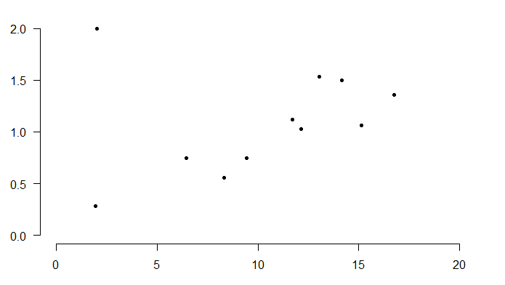
Outliers
What is an outlier?
An observation lying at an abnormal distance from other values in a random sample from a population.
What is “abnormal distance” ?
Is this an outlier ???

Slide 24
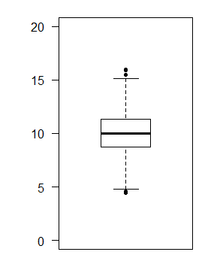
Outliers – visual inspection
Many software packages mark as outliers those points that are outside of certain limits in the distribution.
Example R boxplot
boxplot(x, pch = 20, ylim = c(0, 20))
3rd quart + 1.5 * IQR
(closest point)
3rd quartile (11.32)
Median (10.03)
1st quartile (8.7)
1st quart - 1.5 * IQR
(closest point)
IQR = 11.32-8.7 = 2.62

Slide 25
Outliers – formal tests
There are formal tests to define outliers
Most commonly used:
Grubb’s test
H₀: There are no outliers in the data set
H_{A}: There is exactly one outlier in the data set
Grubb’s test is based on the assumption of normality
R function grubbs.test in package outliers.
> install.packages(outliers) # Need to do this only once!
> library(outliers) # The package needs to be loaded every time
> grubbs.test(x)
Grubbs test for one outlier
data: x
G = 3.43240, U = 0.87979, p-value = 0.02048
alternative hypothesis: highest value 3.65 is an outlier

Slide 26
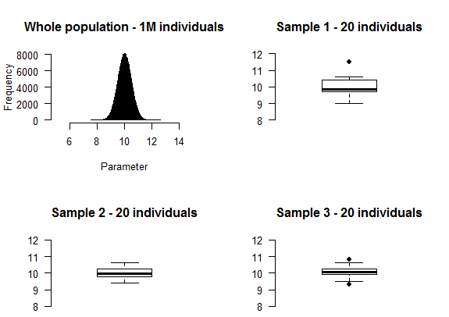
Outliers – what to do?
Should we remove outliers? Generally speaking – not a good idea
Grubb’s test marks this as outlier

Slide 27
Outliers – what to do?
In some cases it is clear that a value has been mis-recorded.
In those cases you can safely remove it or in some instances correct it
Remove:
Impossible values, such as a negative age
A value which is 1000 times bigger than what expected
Correct (with caution):
A value which has clearly been swapped with another one in a spreadsheet
THIS DOES NOT MEAN YOU CAN CORRECT A VALUE BECAUSE IT IS NOT THE RESULT THAT YOU WOULD LIKE TO HAVE!
The best solution is to leave the outlier be… and repeat the experiment more times!

Slide 28
Summary
Producing good results depends on good experimental design
This involves many steps: background research, formulating an hypothesis, collecting data and analyse/interpret them!
Each of these steps is critical
Issues in data collection:
How to collect data?
What format to save it?
What analysis to run?
Dealing with missing data
Dealing with outliers

